Slide 1
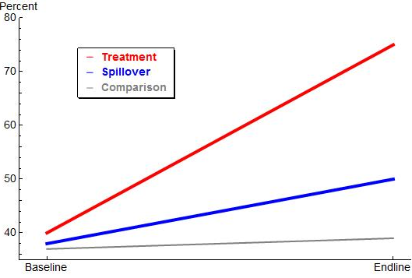
Treatment
effect
Spillover
effect

